Slide 1
Java with Data Bases
Simeon Angelov

Slide 2
10:00 – 11:30 Final exam time
Until 11:30 we do have a final exam
Please follow the given instructions to start it
Good luck to all of you!

Slide 3
Content
Data Bases
Types of databases
SQL vs Non SQL DB’s
Java & DB’s

Slide 4
Databases
Organized collection of structured information
Stored electronically in a computer system / server
Database is controlled by a Database management system (DBMS)
The data could be modules in rows & columns; structured files (JSON,s XML and etc.) and etc.
The data could be modified, managed (added, removed, updated) by applications

Slide 5
Types of databases
Relational databases
Table oriented DB
A set of columns and rows
Defines structure (varchar, number and etc … )
Strong relations between the tables
Examples:
Oracle
MySQL
PostgreSQL
And etc …
user_id | name | city
1 | Gio | Tbilisi
2 | Sofia | London

Slide 6
Types of databases
NoSQL Databases
Non relational databases
The data is unstructured
Example data format
Key-value
JSON’s
XML
And etc
Example DB’s
MongoDB
Redis
Couchbase
And etc
key
value
key
value

Slide 7





Types of databases
Graph Databases
Uses graph structure
Semantic queries for nodes, edges and properties to represent the sore data
A type of NoSQL DB
Example Graph DB’s
Neo4j

Slide 8
SQL vs Non SQL DB’s
 | SQL DB | Non SQL DB
Data Storage Model | Tables with rows and columns | JSON,s XMLs, key-value, Graphs and etc ...
Strong relation? | Yes, well defined relational | Non
Support transactions | Yes | Only few supports it (like Mongo DB)
Highly scalable | Yes, could be and needs well defined infrastructure and rules. Most used scaling strategy – vertical (scale-up larger server) | Yes, designed to be scalable. Most used scaling policy – Horizontal – scale out across commodity servers
Performance | Yes, but depends on how the data is structured | Yes, designed to have fast queries

Slide 9
Java & DB’s
Ways to work with DBs with Java
JDBC (Java Database Connector) library
SQL frameworks like Spring JDBC abstractions
NoSQL frameworks and libraries like JDBC Drivers (Mongo DB Driver and etc … )
ORM (Object Relational Models) like Hibernate or JPA

Slide 10
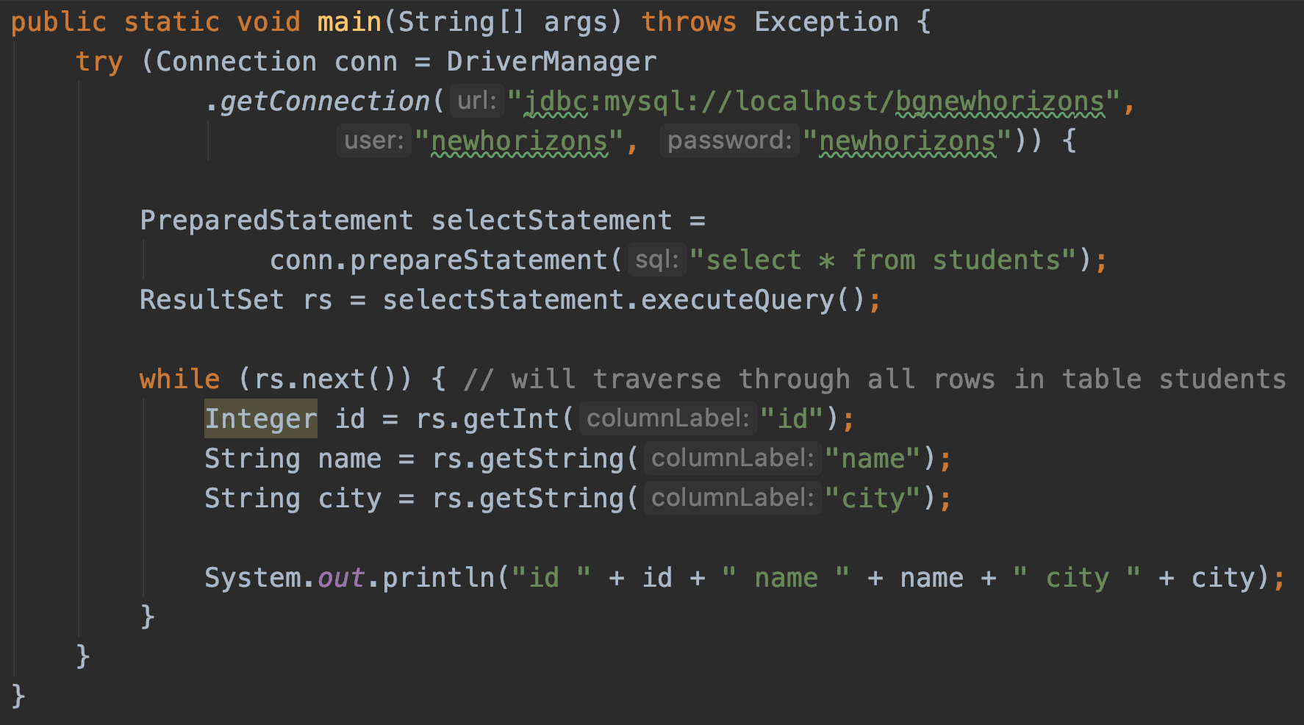
Java & DB’s
JDBC library
-
java.sql.*
id | name | city
1 | Gio | Tbilisi
2 | Sofia | London

Slide 11
Java & DB’s
Hibernate - ORM
@Entity @Table(name="students") public class Student { @Id @GeneratedValue(strategy = GenerationType.AUTO) private Integer id; @Column private String name; @Column private String city; }
Then, with a built SessionFactory, retrieving a Session within which we can
Delete
Create
Update

Slide 12
Java & DB’s
And many frameworks for any kind of DB – SQL or Non SQL DB
Spring framework gives a range of already to use frameworks for working with almost any most used database
Spring data for Mongo Db
Spring data Redis for Redis DB
And many more

Slide 13
Questions?
Notes:
Do you have any questions?

Slide 14
Thank You For Your Time

